Slide 1
The Impact of AI Adoption on
Scientific Surprise in
Academic Research
Ben Heim & Adam Tuchler
University of Chicago | March 2026
Notes:
Adam

Slide 2
Research Question
Does AI adoption causally increase the disciplinary breadth of academic citations?
Approach
Diff-in-diff with continuous treatment across 16 academic fields
Treatment intensity: GPT-3.5 marker word adoption (Kobak et al. 2024)
Treatment event: Release of GPT-4o (November 2024)
Outcome: Shannon entropy of citation field distributions
35,080 papers from OpenAlex (May 2023 – Dec 2025)
Notes:
Adam

Slide 3
Prior Work
Hao et al. (2026, Nature)
AI contracts knowledge extent
Binary classification of AI-augmented papers across 41M articles. Finds AI use reduces the "diameter" of knowledge covered. Focuses on AI as a research method, not LLM-assisted writing specifically.
Algaba et al. (2025, NAACL)
LLMs mirror & amplify citation bias
Analyzes 275K AI-suggested references. LLMs reflect human citation patterns but with a heightened Matthew effect — systematically favoring already highly-cited, high-profile work. Studies what LLMs recommend, not what researchers actually do.
Notes:
Ben
Three key papers set the stage for our work. Hao et al. find AI contracts the breadth of knowledge in papers. Algaba et al. show LLMs amplify existing citation biases — favoring already-popular work.

Slide 4
Prior Work
Hao et al. (2026, Nature)
AI contracts knowledge extent
Binary classification of AI-augmented papers across 41M articles. Finds AI use reduces the "diameter" of knowledge covered. Focuses on AI as a research method, not LLM-assisted writing specifically.
Algaba et al. (2025, NAACL)
LLMs mirror & amplify citation bias
Analyzes 275K AI-suggested references. LLMs reflect human citation patterns but with a heightened Matthew effect — systematically favoring already highly-cited, high-profile work. Studies what LLMs recommend, not what researchers actually do.
Kusumegi et al. (2025, Science)
LLMs boost output, broaden citations
Diff-in-diff on 2.1M preprints. LLM adopters produce 24–89% more papers and cite more diverse sources (books, younger works). However, research quality declines — sophisticated language masks weaker manuscripts.
Our contribution: causal identification of how LLM adoption affects cross-field citation entropy using continuous treatment intensity
Notes:
Ben
Kusumegi et al. use diff-in-diff like us and find LLM adopters cite more diversely, but paper quality declines. Our contribution is causal identification of how LLM adoption affects cross-field citation entropy specifically, using continuous treatment intensity.

Slide 5
Prior Work
Hao et al. (2026, Nature)
AI contracts knowledge extent
Binary classification of AI-augmented papers across 41M articles. Finds AI use reduces the "diameter" of knowledge covered. Focuses on AI as a research method, not LLM-assisted writing specifically.
Algaba et al. (2025, NAACL)
LLMs mirror & amplify citation bias
Analyzes 275K AI-suggested references. LLMs reflect human citation patterns but with a heightened Matthew effect — systematically favoring already highly-cited, high-profile work. Studies what LLMs recommend, not what researchers actually do.
Kusumegi et al. (2025, Science)
LLMs boost output, broaden citations
Diff-in-diff on 2.1M preprints. LLM adopters produce 24–89% more papers and cite more diverse sources (books, younger works). However, research quality declines — sophisticated language masks weaker manuscripts.
Our contribution: causal identification of how LLM availability affects cross-field citation entropy using continuous treatment intensity
Notes:
Ben
Kusumegi et al. use diff-in-diff like us and find LLM adopters cite more diversely, but paper quality declines. Our contribution is causal identification of how LLM availability affects cross-field citation entropy specifically, using continuous treatment intensity.

Slide 6
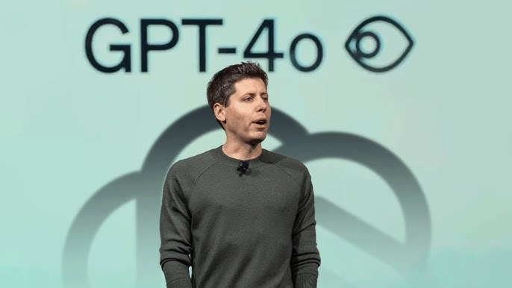
Why ChatGPT 4o?
Does AI adoption causally increase the disciplinary breadth of academic citations?
First model release where frontier lab multimodal model access was available to any researcher for free.
Not the only model that fits these specifications but is a clean break in accessibility of high-quality models.
Notes:
Ben
Why GPT-4o? It was the first time a frontier-quality model was available to every researcher for free — no paywall. Competitors offered free tiers, but those ran weaker models. 4o marks a clean break in accessibility.

Slide 7
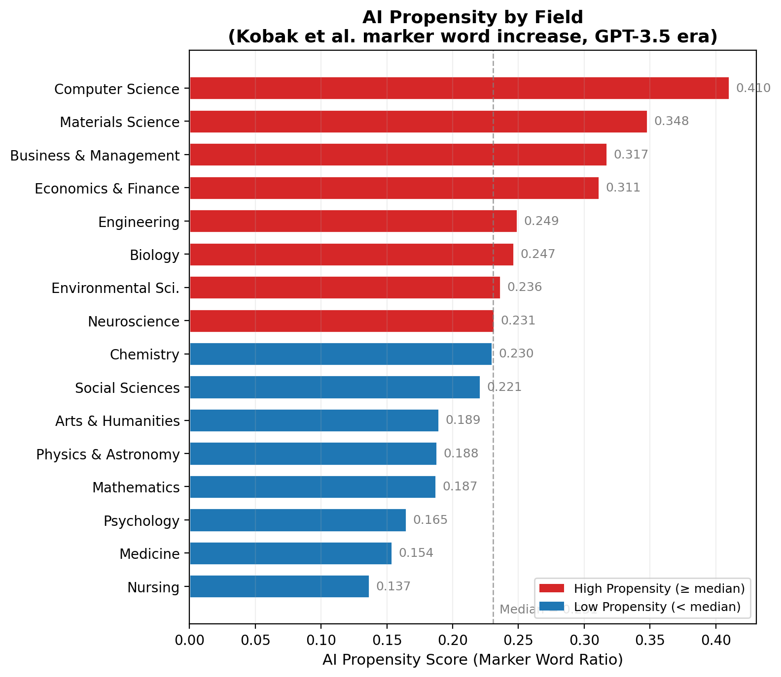
Measuring AI Adoption: Propensity Scores
Increase in Kobak marker word frequency from pre- to post-ChatGPT (GPT-3.5) era
Kobak measure examines frequency of style words commonly associated with LLMs
We measure AI propensity by using (marker words per million 6 months after GPT 3.5 release – marker words per million before GPT 3.5 release)/(marker words per million before GPT 3.5 release)
Notes:
Adam

Slide 8
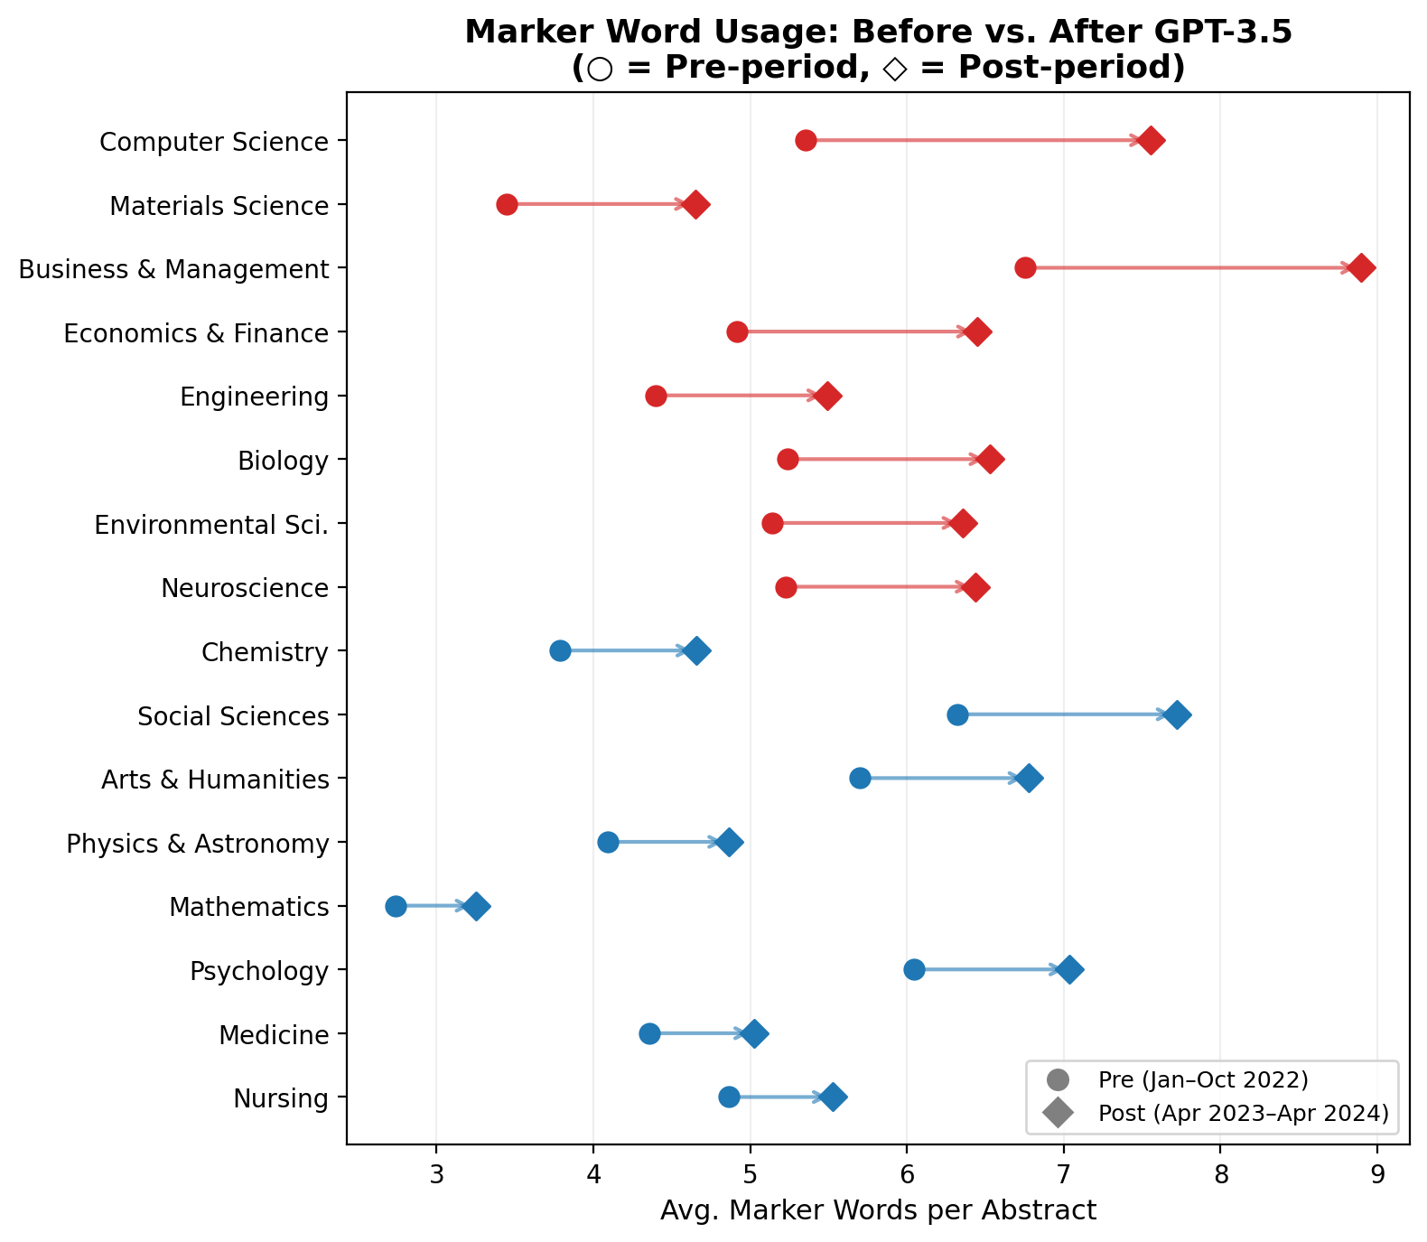
Marker Word Adoption Increases Across Fields
All 16 fields show increases after ChatGPT release, but magnitude varies substantially
All fields see an increase in LLM-associated words between the pre and post period.
NB: we always delay our treatment impact measurement 6 months after a model release – this is due to the period of time it takes between paper submission and publication
Notes:
Adam

Slide 9
Regression Specification
Diff-in-diff with continuous treatment intensity and monthly trend
Yᵢft = α + β₁(Af × Dt) + β₂(Af × Tt) + γ′Xᵢft + δf + θt + εᵢft
Key Variables
Yᵢft Shannon entropy of paper i in field f at time t
Af AI propensity score (Kobak marker word increase, field f)
Dt = 1 if post-GPT-4o (Nov 2024+)
Tt = max(0, months since Nov 2024)
Controls & Fixed Effects
Xᵢft Num. authors, institutions, countries
δf Field fixed effects (16 fields)
θt Year-month fixed effects
εᵢft HC1 robust standard errors
β₁ captures the level shift at treatment. β₂ captures the monthly trend post-treatment — consistent with gradual LLM diffusion.

Slide 10
Shannon Entropy – Measuring Citation Diversity
All 16 fields show increases after ChatGPT release, but magnitude varies substantially
Hᵢ = – Σ pᵢ(g) · ln pᵢ(g)
where pᵢ(g) = share of paper i's references classified in field g
What it captures
We observe how each paper distributes its citations across OpenAlex’s 26 fields
Shannon entropy measures how spread out that distribution is (breadth and evenness)
Intuition
All citations in one field -> H = 0 Nats
Equal citations across all fields -> H = ln(26) ≈ 3.26 (max diversity)
Notes:
Ben
Our outcome measure is shannon entropy captures how evenly a paper spreads its citations across 26 academic fields. Zero means all citations in one field. The maximum, log 26, means perfectly even across all fields.

Slide 11
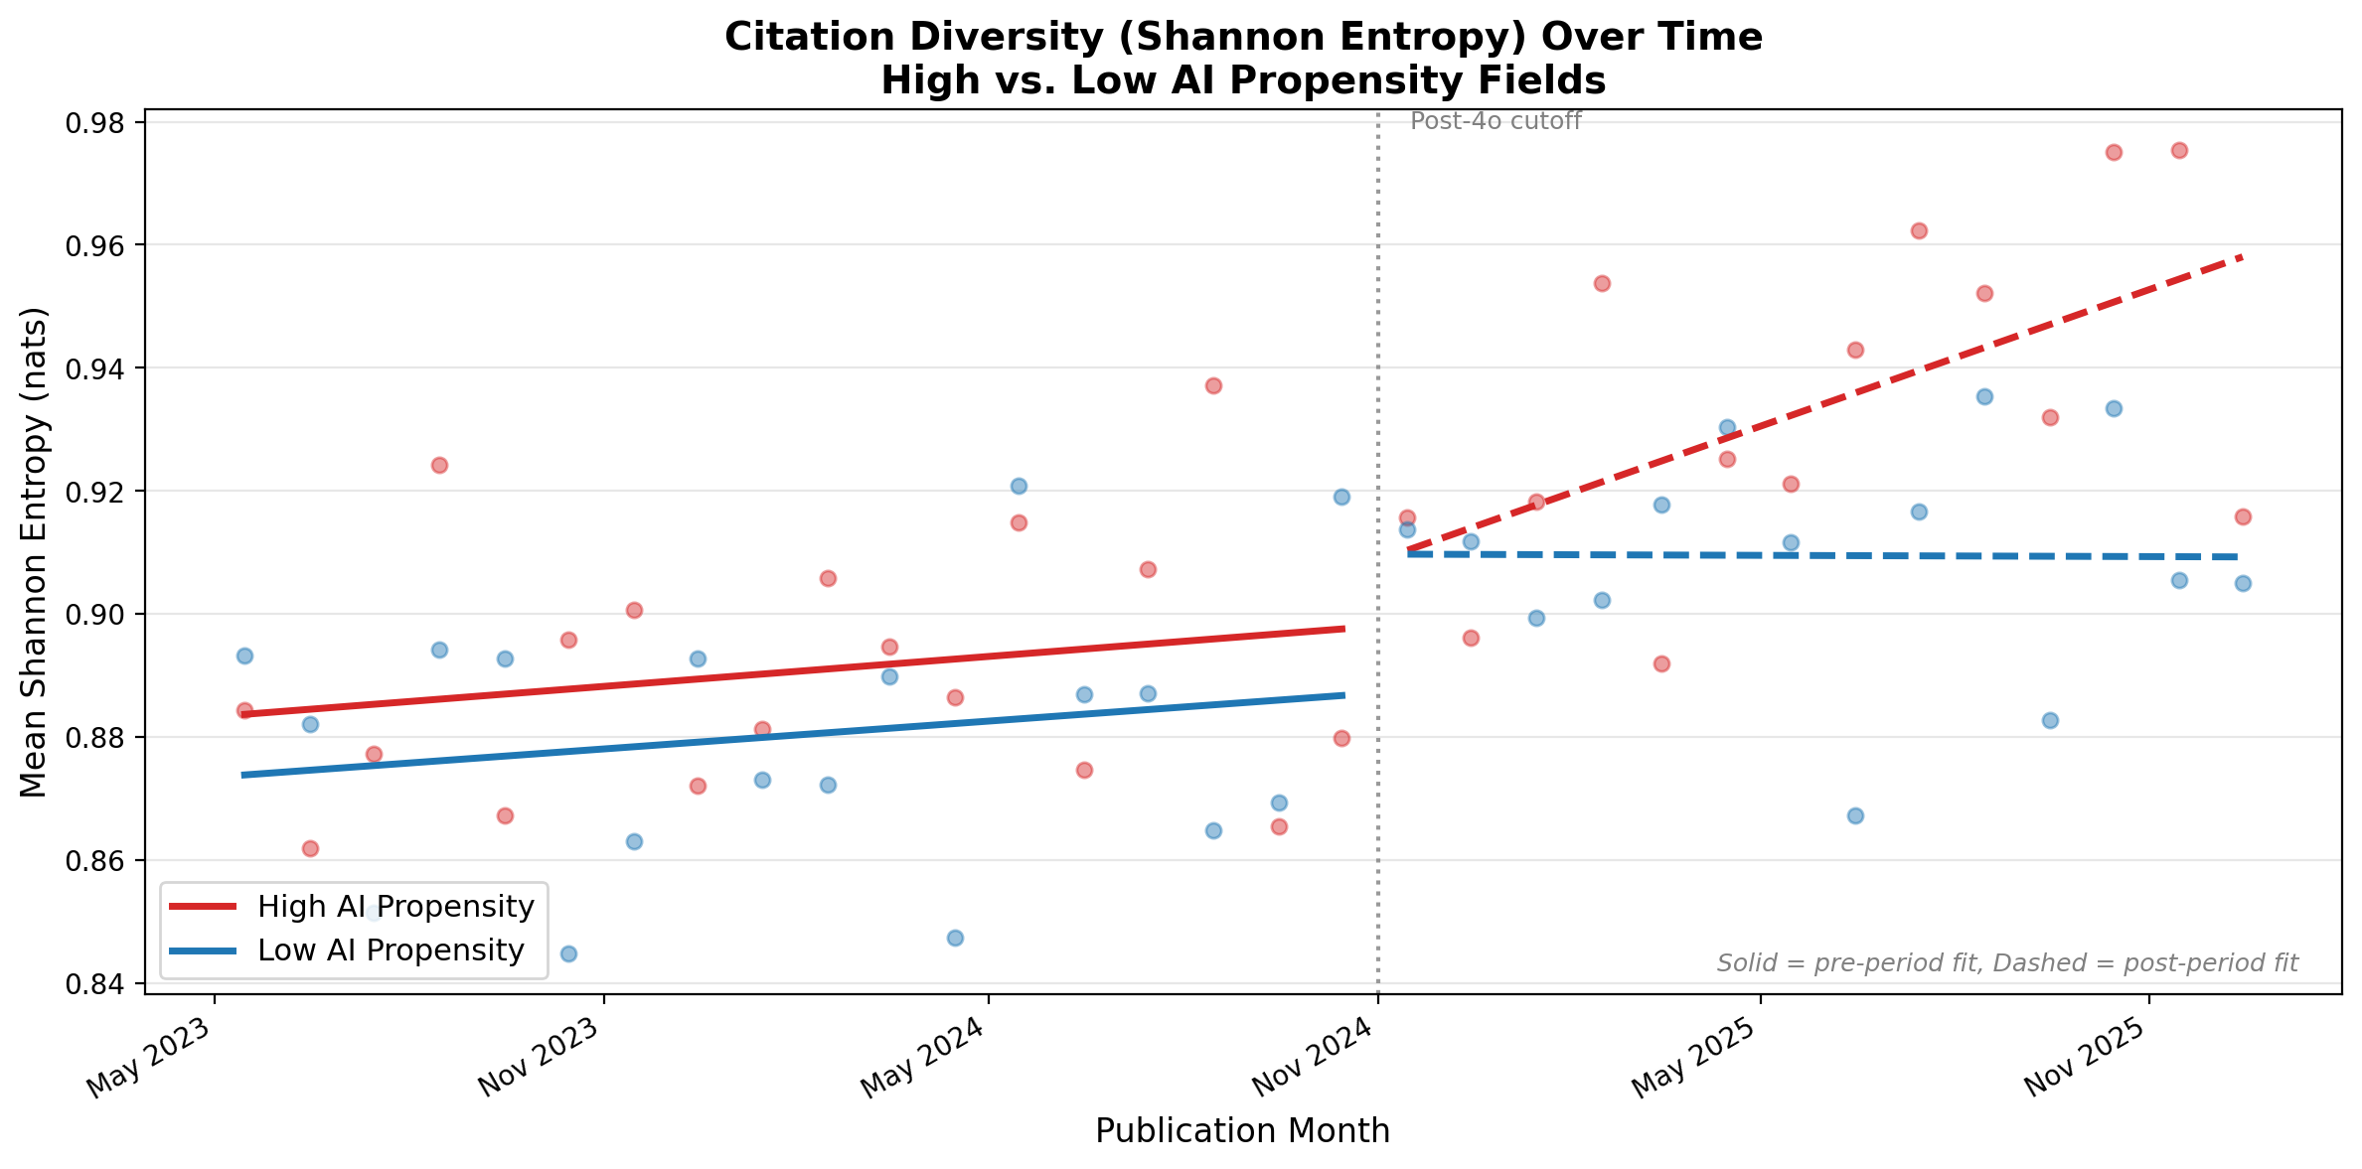
Main Result: Citation Entropy Diverges Post-4o
High-propensity fields show steeper entropy increase after GPT-4o release
Notes:
Ben
Here's the main result. After GPT-4o, fields with higher AI propensity — meaning they adopted GPT-3.5 language more heavily — show a steeper increase in citation entropy.

Slide 12
Main Result: Citation Entropy Diverges Post-4o
High-propensity fields show steeper entropy increase after GPT-4o release
Notes:
Ben
The divergence is clear and grows over time, which is consistent with gradual diffusion of LLM use rather than an overnight shock. This motivates the trend specification in our regression which Adam will share more about.

Slide 13
Main Result: Citation Entropy Diverges Post-4o
High-propensity fields show steeper entropy increase after GPT-4o release
 | (1) Level | (2) Trend
Propensity Jump (β₁) | 0.170*** | –0.044
 | (0.068) | (0.106)
Propensity Trend (Monthly) (β₂) |  | 0.031***
Controls: |  | (0.012)
Num. authors | 0.001 | 0.001
Distinct institutions | –0.000*** | –0.000***
Distinct countries | 0.015*** | 0.015***
Field FE | Yes | Yes
Year-month FE | Yes | Yes
N | 35,080 | 35,080
R² | 0.143 | 0.143
Both jump gradual trend are separately significant
Gradual trend better describes impact than singular-time jump
This makes sense as it takes time to adopt new models into a workflow
HC1 robust standard errors in parentheses. *** p < 0.01, ** p < 0.05, * p < 0.10
Notes:
Adam

Slide 14
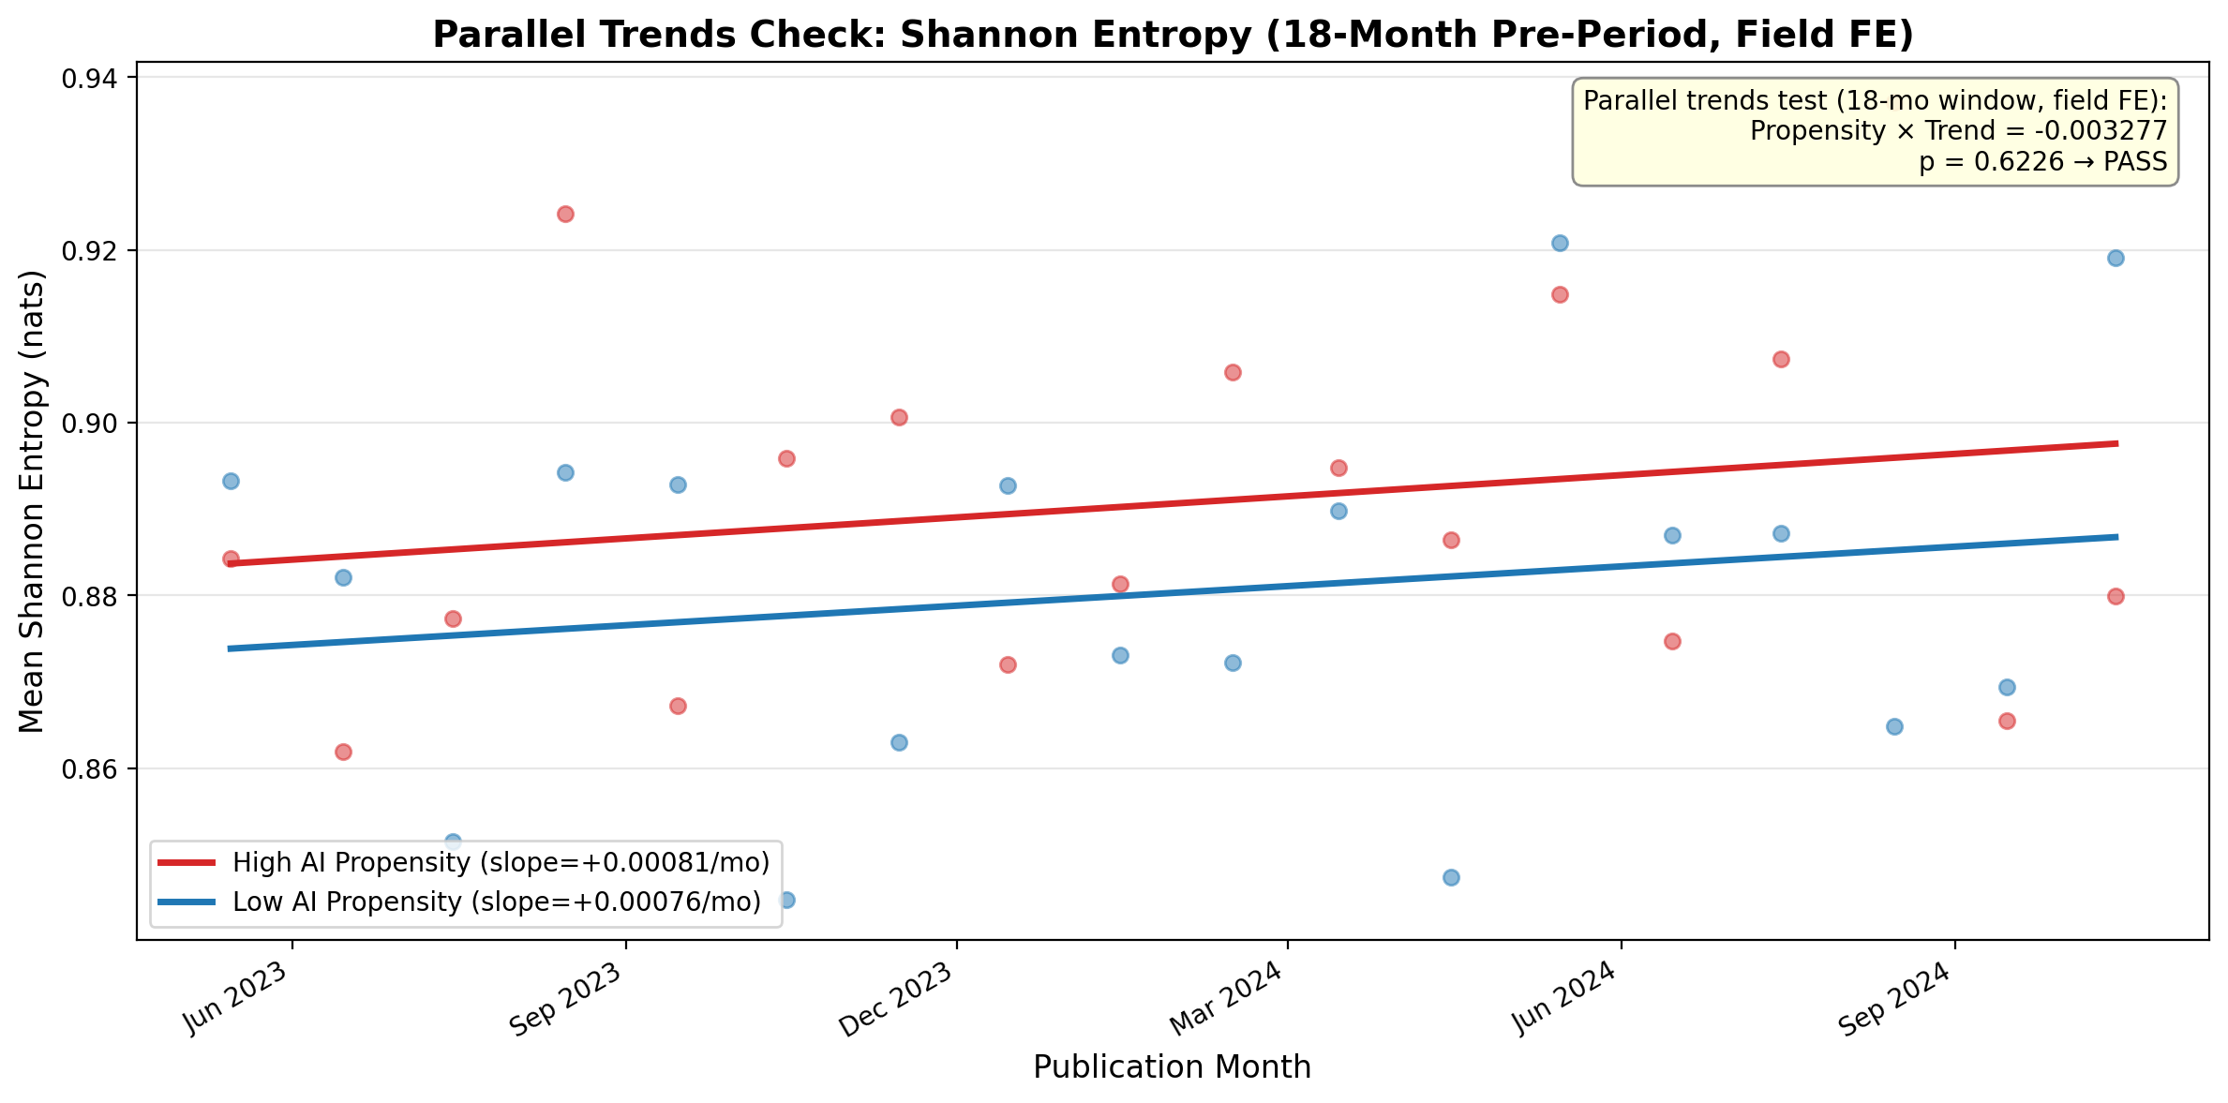
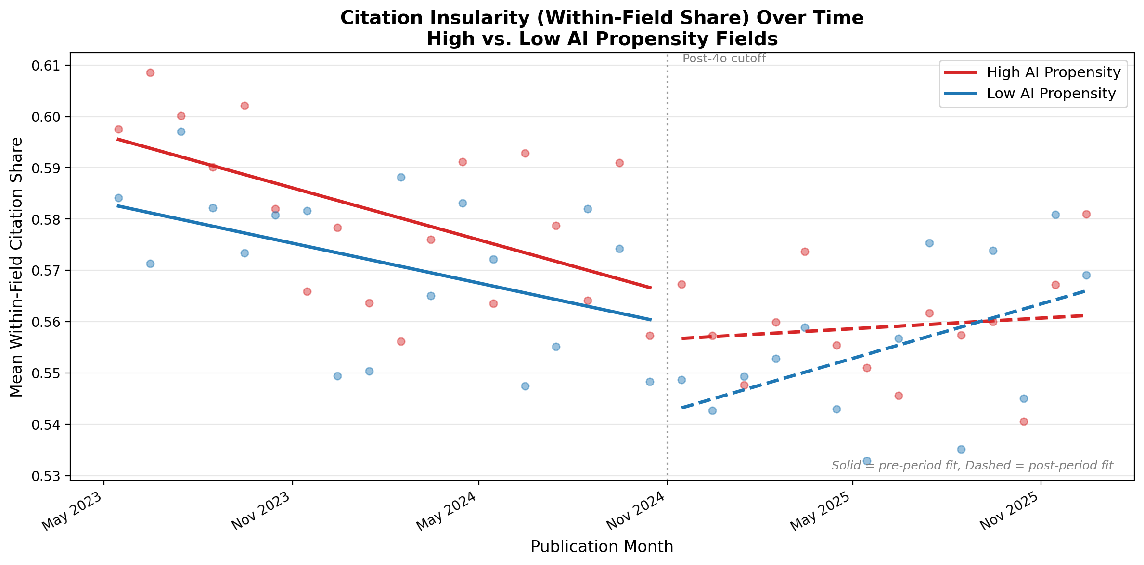
Robustness: Parallel Trends & Within-Field Share
We expect parallel trends for the development of high AI propensity and low AI propensity fields before treatment
We expect within-field share of citations to drop more in high AI fields than in low AI fields
Parallel trends pass (p = 0.56) in 18-month
pre-period with field FE
Within-field citation share declines faster
in high-propensity fields post-4o
Notes:
Adam

Slide 15
Robustness: Parallel Trends & Within-Field Share
We expect parallel trends for the development of high AI propensity and low AI propensity fields before treatment
We expect within-field share of citations to drop more in high AI fields than in low AI fields
Parallel trends pass (p = 0.56) in 18-month
pre-period with field FE
Within-field citation share declines faster
in high-propensity fields post-4o
Notes:
Adam

Slide 16
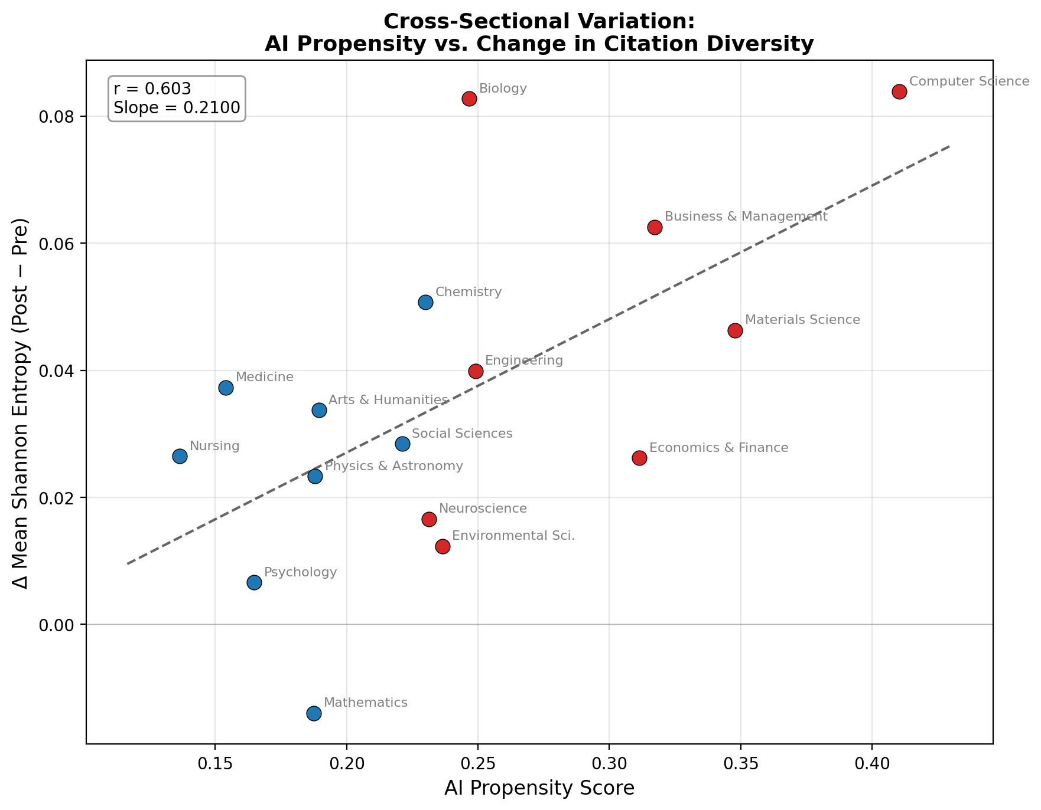
Cross-Sectional Validation
Fields with higher AI propensity saw larger increases in citation diversity (r = 0.603)
Dose-Response: Higher Propensity -> Larger Entropy Gains
While no longer controlling for other variables, this offers a clean visualization of the effect we find in our regression specification

Slide 17
Limitations
1
GPT-3.5 adoption may not predict GPT-4o adoption
Propensity scores capture structural field-level receptivity to LLM assistance, not adoption of a specific model. Measured during a pre-“gaming” period when there was no reputational cost to AI-influenced writing.
2
Concurrent LLM releases confound the GPT-4o effect
Claude, Gemini, and Llama improved over the same period. Our estimand is best interpreted as the effect of crossing a broad AI accessibility threshold — GPT-4o was the first frontier model available for free — not the effect of one product.
3
Propensity reflects field structure, not individual behavior
We cannot distinguish whether high-propensity fields adopt LLMs because of structural workflow amenability or because of demographic composition (e.g., younger, more tech-savvy researchers). Field FE absorb level differences, but the interaction could still reflect composition.
Notes:
Adam

Slide 18
Limitations
1
GPT-3.5 adoption may not predict GPT-4o adoption
Propensity scores capture structural field-level receptivity to LLM assistance, not adoption of a specific model. Measured during a pre-“gaming” period when there was no reputational cost to AI-influenced writing.
2
Concurrent LLM releases confound the GPT-4o effect
Claude, Gemini, and Llama improved over the same period. Our estimand is best interpreted as the effect of crossing a broad AI accessibility threshold — GPT-4o was the first frontier model available for free — not the effect of one product.
3
Propensity reflects field structure, not individual behavior
We cannot distinguish whether high-propensity fields adopt LLMs because of structural workflow amenability or because of demographic composition (e.g., younger, more tech-savvy researchers). Field FE absorb level differences, but the interaction could still reflect composition.
Notes:
Adam

Slide 19
Key Takeaways
1
LLM Adoption Causes an Increase in Citation Diversity
Shannon entropy increase post ChatGPT 4o introduction is modulated by AI propensity score
Ben Heim & Adam Tuchler | University of Chicago
Notes:
Ben
So to wrap up — our first takeaway: LLM adoption causally increases citation diversity. The Shannon entropy increase post-4o is proportional to each field's AI propensity score.

Slide 20
Key Takeaways
1
LLM Adoption Causes an Increase in Citation Diversity
Shannon entropy increase post ChatGPT 4o introduction is modulated by AI propensity score
2
Effect is gradual, not a jump
Treatment × trend specification fits better than level shift — consistent with diffusion
Ben Heim & Adam Tuchler | University of Chicago
Notes:
Ben
Second, the effect is gradual, not a discrete jump. The trend specification fits better than the level shift, which is what you'd expect from a technology diffusing through research workflows over months.

Slide 21
Key Takeaways
1
LLM Adoption Causes an Increase in Citation Diversity
Shannon entropy increase post ChatGPT 4o introduction is modulated by AI propensity score
2
Effect is gradual, not a jump
Treatment × trend specification fits better than level shift — consistent with diffusion
3
Consistent across measures
Entropy, distinct fields cited, and within-field share all point the same direction
Ben Heim & Adam Tuchler | University of Chicago
Notes:
Ben
Third, this isn't just one measure. Entropy, distinct fields cited, and within-field share all tell the same story — higher AI propensity fields diversify their citations more.

Slide 22
Key Takeaways
1
LLM Adoption Causes an Increase in Citation Diversity
Shannon entropy increases by +0.031 nats/month in high-propensity fields post-4o. This is a robust finding.
2
Effect is gradual, not a jump
Treatment × trend specification fits better than level shift — consistent with diffusion
3
Consistent across measures
Entropy, distinct fields cited, and within-field share all point the same direction
4
Complements existing literature
Hao et al. (2026) find AI contracts knowledge extent; we find it expands citation breadth
Ben Heim & Adam Tuchler | University of Chicago
Notes:
Ben
And finally, our findings complement the existing literature. Hao et al. find AI contracts knowledge extent, but we find it expands citation breadth — these are different margins. More diverse citing doesn't contradict narrower topics.

Slide 23
Future Work
1
Do cross-disciplinary citations produce lasting impact?
Track forward citations, disruption indices (CD₅), and knowledge persistence of AI-era papers over 3–5 years. Tests whether the entropy increase we document translates into genuine knowledge integration or superficial breadth — directly engaging Hao et al.’s knowledge contraction and Kusumegi et al.’s quality decline findings.
2
Disentangle the mechanism
Are researchers discovering new literatures through LLM suggestions (Algaba’s channel), or does LLM-assisted writing lower the cost of integrating sources they already knew about? Experimental or survey-based designs could separate these pathways.
Notes:
Adam

Slide 24
Future Work
1
Do cross-disciplinary citations produce lasting impact?
Track forward citations, disruption indices (CD₅), and knowledge persistence of AI-era papers over 3–5 years. Tests whether the entropy increase we document translates into genuine knowledge integration or superficial breadth — directly engaging Hao et al.’s knowledge contraction and Kusumegi et al.’s quality decline findings.
2
Disentangle the mechanism
Are researchers discovering new literatures through LLM suggestions (Algaba’s channel), or does LLM-assisted writing lower the cost of integrating sources they already knew about? Experimental or survey-based designs could separate these pathways.
Notes:
Adam

Slide 25
Policy Implications
Notes:
Adam

